Slide 1
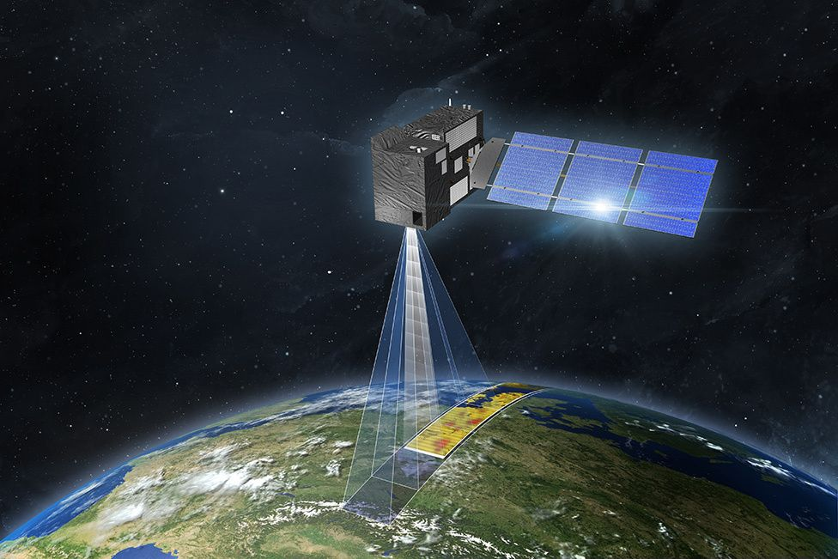
Land Use Classification using Satellite Image Datasets
AT82.03 Machine Learning
Group 2: Md. Sakib Bin Alam - st122574
Anjana Tissera - st123459
Aiman Lameesa - st122876
Notes:
Sakib

Slide 2
Introduction
With earth’s climate rapidly changing, efficient use of natural resources such as land has become increasingly important.
Our project focus on Land Use and Land Classification (LULC) which can immensely assist:
Efficient monitoring of land use changes
Effective land cover planning and management
Advancements in satellite imagery and deep learning technologies can facilitated highly accurate LULC classification.
Notes:
Sakib

Slide 3
Introduction
Our study focus on LULC classification by:
Training, custom-built CNNs from scratch
Applying transfer learning to fine-tune pre-trained networks such as AlexNet and ResNet for LULC classification
Notes:
Sakib

Slide 4
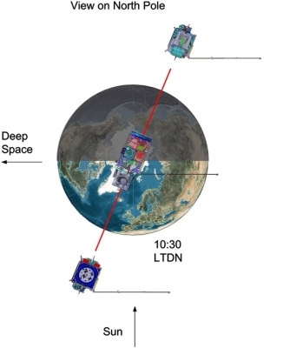
Datasets
Agencies such as NASA, USGS and European Space Agency (ESA) provides free and open access to images datasets from some of their satellites.
Landsat satellite image datasets from NASA and USGS
Image datasets from series of Sentinel satellites (Sentinel-1, Sentinel-2, Sentinel-3, and Sentinel-5P) by ESA
We selected, EuroSAT dataset based on the Sentinel-2 satellite.
Fig: SENTINEL-2 Orbital Configuration
SENTINEL-2
Identical twin satellites flying in the same orbit but phased at 180°
High revisit frequency of 5 days at the Equator.
Its optical equipments sample 13 spectral bands
The orbital swath width is 290 km.
Notes:
Anjana

Slide 5
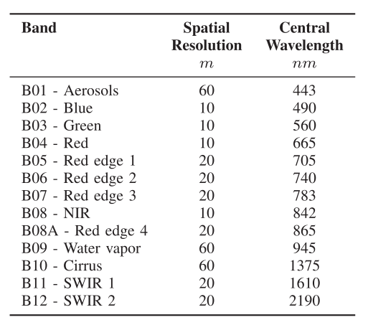
EuroSAT Dataset from Sentinel-2 Satellite
Consists of 27000 labelled images
10 classes:
Annual Crop, Forest, Herbaceous Vegetation, Highway, Industrial, Pasture, Permanent Crop, Residential River, and Sea/Lake
13 spectral bands
Georeferenced
Ground truth accuracy is validated using European Urban Atlas
A cloud free dataset
Fig: EuroSAT Multispectral Imager (MSI) Dataset - Band Specifications
Notes:
Anjana

Slide 6
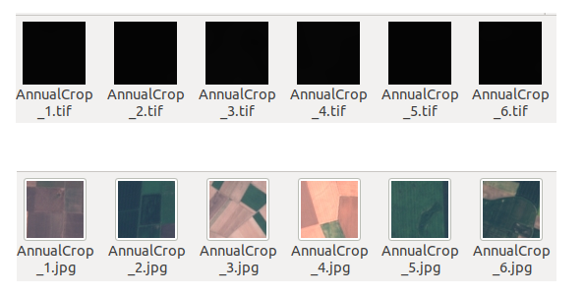
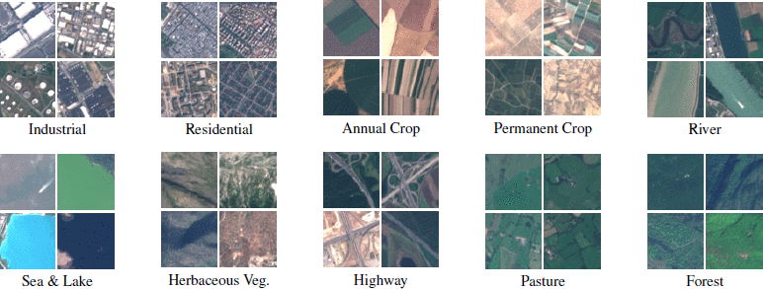
EuroSAT Dataset from Sentinel-2 Satellite
Fig: Extracting RGB channels from Multispectral Imager (MSI) Dataset
Extract RGB Channels
Fig: Overview of RGB Image Dataset
Notes:
Anjana

Slide 7
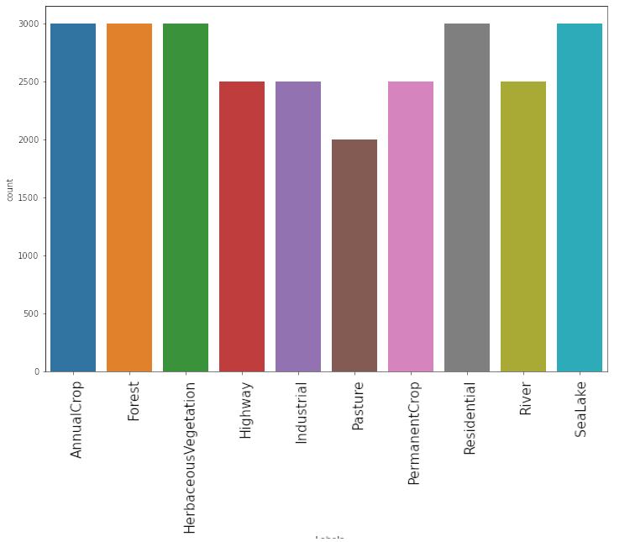
EuroSAT Dataset Classes
Fig: Image count in EuroSAT Dataset Classes
Notes:
Anjana

Slide 8
Methodology
Deep Learning Model Training
Data Preparation
Evaluation
Transfer Learning
EuroSat MSI Dataset
Custom Built CNN
ResNet
AlexNet
Loss and Accuracy
Extract RGB Channels
AlexNet Ver. 1
CNN Ver. 1
ResNet Ver. 1
Confusion Matrix
RGB Dataset
CNN Ver. 2
ResNet Ver. 2
AlexNet Ver. 2
Misclassified Images Analysis
Train. Validation, and Test Split
CNN Ver. 3
ResNet Ver. 3
AlexNet Ver. 3
Notes:
Aiman

Slide 9
Land Use Classification using CNN
Our first approach for Land Use Classification was to train CNN models from scratch.
 | CNN Model 1 | CNN Model 2 | CNN Model 3
Total number of parameters | 1233674 | 2144890 | 2243547
Total number of layers | 2 | 5 | 7
Total number of Conv. layers | 1 | 2 | 3
Total number of linear layers | 1 | 3 | 4
Notes:
Aiman

Slide 10
Architecture of CNN Model 1
Convolution Layer 1
in channel = 3, out channel = 128
kernel size = 3X3, stride = 1, padding = 0
ReLU
MaxPooling Layer
kernel size = 2X2
Dropout Layer
Probability = 20%
Linear Layer
in size = 128*31*31, out size = 10
Notes:
Aiman

Slide 11
Architecture of CNN Model 2
BatchNorm Layer 2
Convolution Layer 1
in channel = 3, out channel = 128
kernel size = 3X3, stride = 1, padding = 0
MaxPooling Layer 2
kernel size = 2X2
ReLU
Linear Layer 1
in size = 256*14*14, out size = 100
BatchNorm Layer 1
ReLU
MaxPooling Layer 1
kernel size = 2X2
Dropout Layer
Probability = 20%
Linear Layer 2
in size = 100, out size = 50
Convolution Layer 2
in channel = 128, out channel = 256
kernel size = 3X3, stride = 1, padding = 0
ReLU
Dropout Layer
Probability = 20%
ReLU
Linear Layer 3
in size = 50, out size = 10
Notes:
Aiman

Slide 12
Architecture of CNN Model 3
Convolution Layer 1
in channel = 3, out channel = 64
kernel size = 3X3, stride = 1, padding = 0
ReLU
BatchNorm Layer 3
MaxPooling Layer 3
kernel size = 2X2
ReLU
BatchNorm Layer 1
Linear Layer 1
in size = 256*6*6, out size = 200
MaxPooling Layer 1
kernel size = 2X2
ReLU
Dropout Layer
Probability = 20%
Convolution Layer 2
in channel = 64, out channel = 128
kernel size = 3X3, stride = 1, padding = 0
Linear Layer 2
in size = 200, out size = 100
ReLU
ReLU
Dropout Layer
Probability = 20%
BatchNorm Layer 2
MaxPooling Layer 2
kernel size = 2X2
Linear Layer 3
in size = 100, out size = 75
ReLU
Convolution Layer 3
in channel = 128, out channel = 256
kernel size = 3X3, stride = 1, padding = 0
Dropout Layer
Probability = 20%
Linear Layer 4
in size = 75, out size = 10
Notes:
Sakib

Slide 13
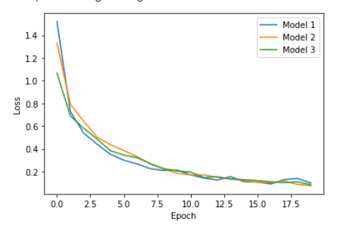
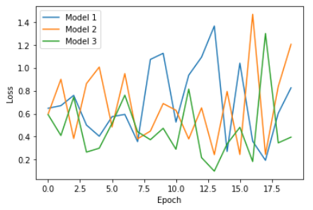
CNN Models - Comparison of Training and Validation Loss
Fig: Training Loss
Fig: Validation Loss
Notes:
Sakib

Slide 14
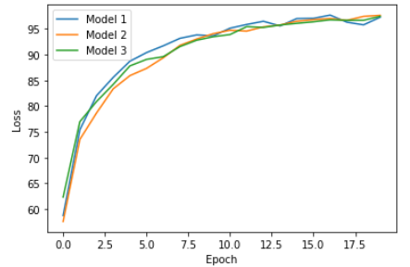
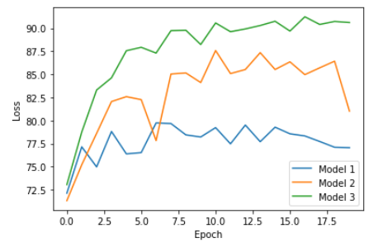
CNN Models - Comparison of Training and Validation Accuracy
Fig: Training Accuracy
Fig: Validation Accuracy
Notes:
Sakib

Slide 15
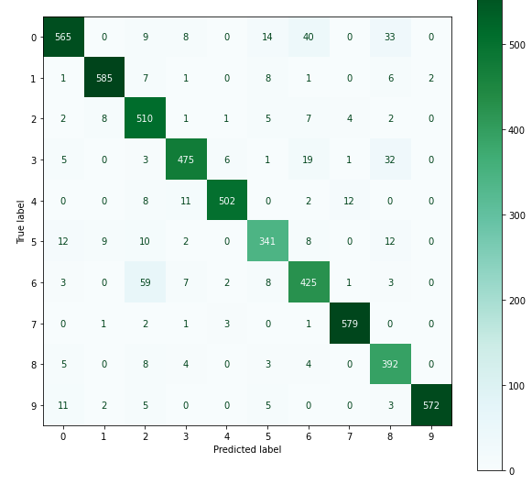
CNN Model - Version 3
Fig: Confusion matrix
Maximum confusion is Permanent Crop being classified as Herbaceous Vegetation
Notes:
Aiman

Slide 16
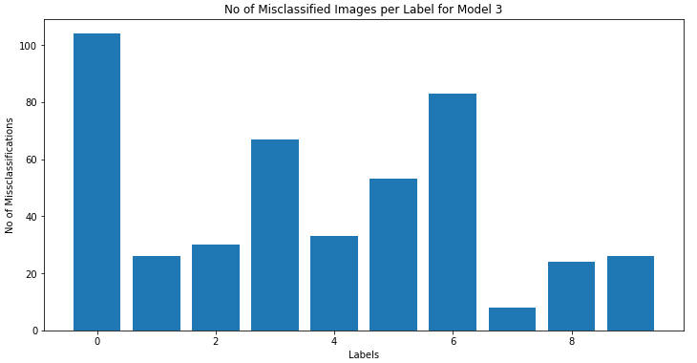
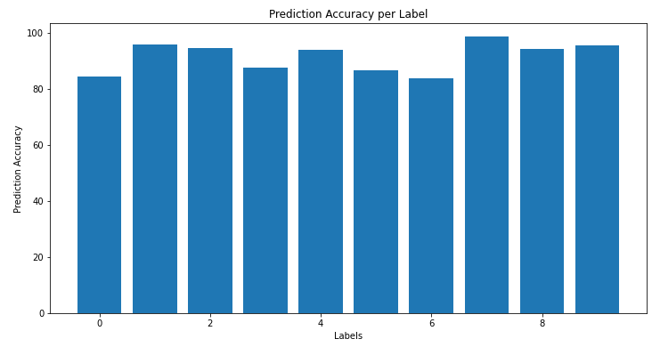
CNN Model - Version 3
Total Misclassified Images: 227 / 2700
Fig: No. of Misclassified Images per Label, Prediction Accuracy per Label
Notes:
Aiman

Slide 17
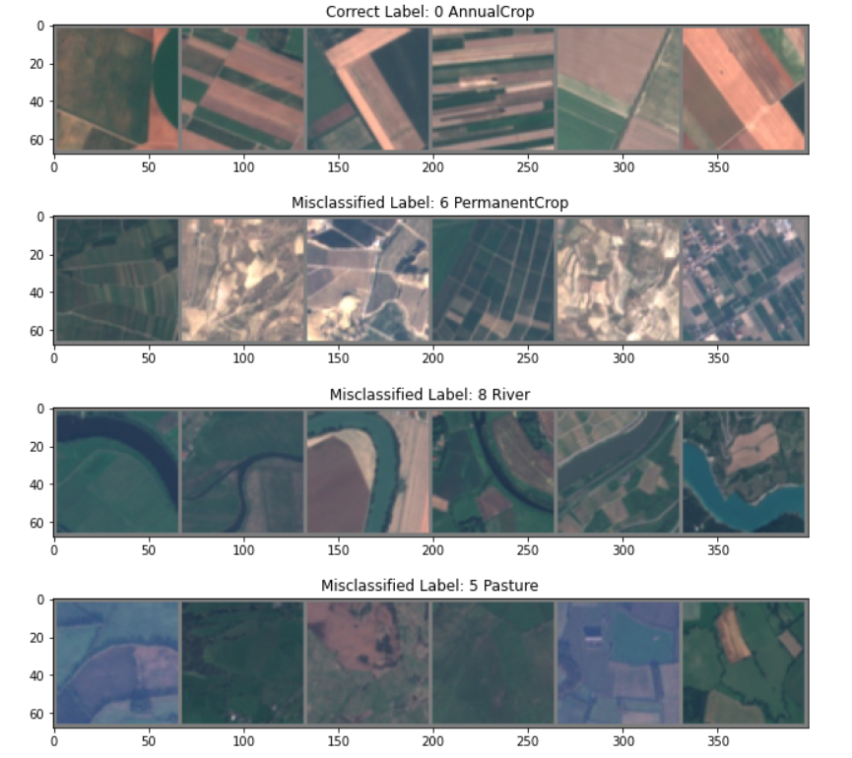
CNN Model - Version 3
Top misclassified Label:
Annual Crop
Fig: Samples misclassified images
for Annual Crop
Notes:
Aiman

Slide 18
Land Use Classification with Transfer Learning - ResNet
Based on: Pytorch ResNet50 v1.5 model, Weights: ResNet50_Weights.IMAGENET1K_V2
ResNet - V1
ResNet - V2
ResNet - V3
Feature extraction only
Remove FC layer’s head from the pre-trained network and replace it with a softmax classifier.
Weights in the body of the CNN are frozen
Performed finetuning
Remove the FC layer head from the pre-trained network
New FC layer
Two Linear hidden layers with ReLU and Dropout
Softmax output layer
Weights in the body of the CNN are frozen
Performed finetuning
Remove the FC layer head from the pre-trained network
New FC layer
Two Linear hidden layers with ReLU and Dropout
Softmax output layer
Trained both the FC layer head and the body of the network
Except BatchNorm2d layers
Notes:
Anjana

Slide 19
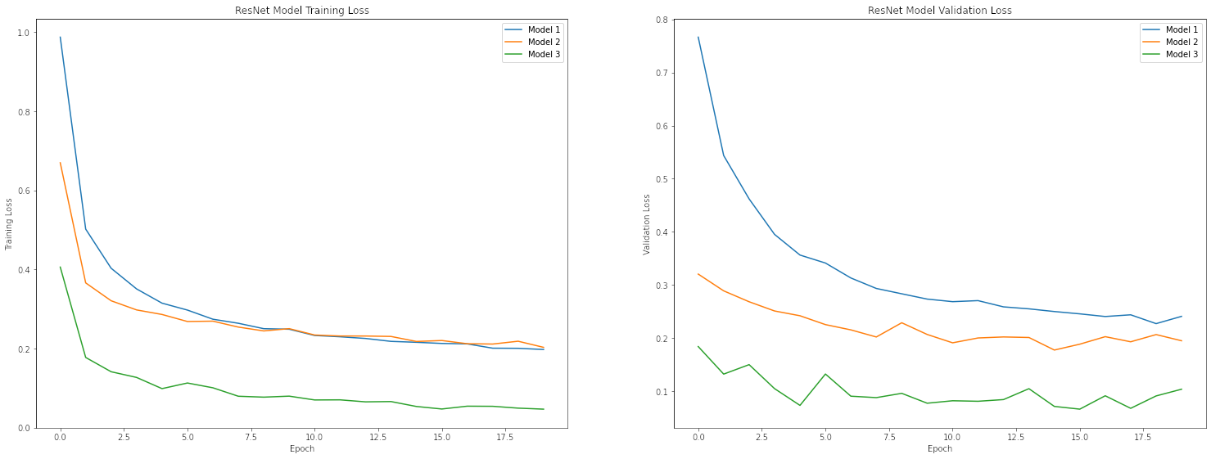
ResNet Models - Comparison of Training and Validation Loss
Notes:
Anjana

Slide 20
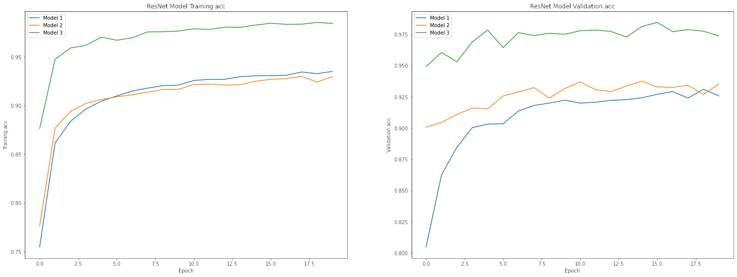
ResNet Models - Comparison of Training and Validation Accuracy
Notes:
Anjana

Slide 21
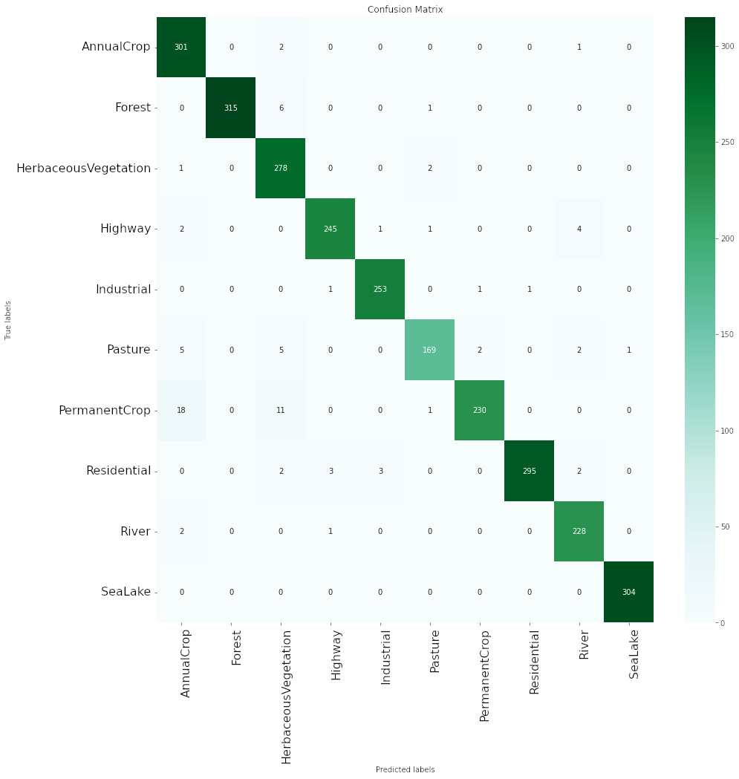
ResNet Models - Version 3
Fig: Confusion matrix
Maximum confusion is Permanent Crop being classified as Annual Crop
Notes:
Anjana

Slide 22
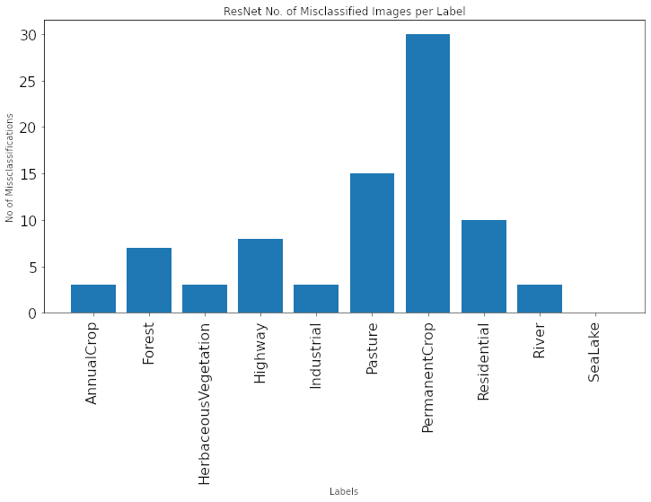
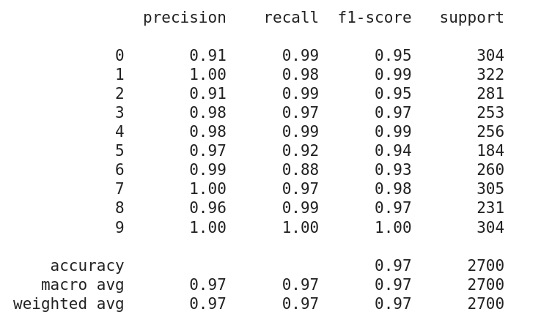
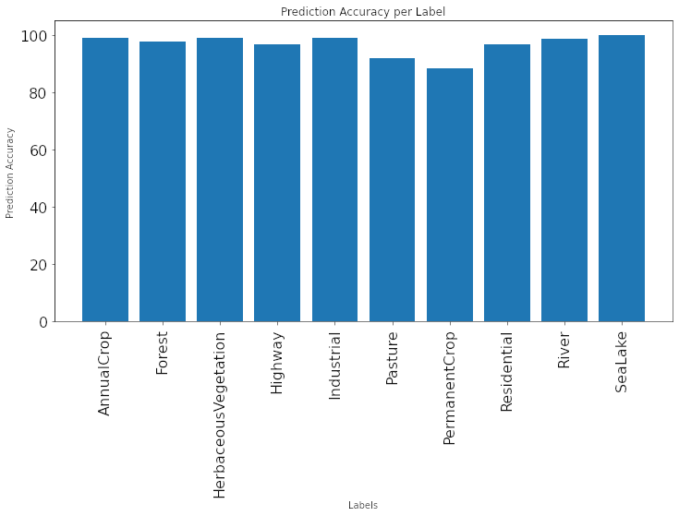
ResNet Models - Version 3
Total Misclassified Images: 82 / 2700
Fig: No. of Misclassified Images per Label, Prediction Accuracy per Label and Classification Report
Notes:
Anjana

Slide 23
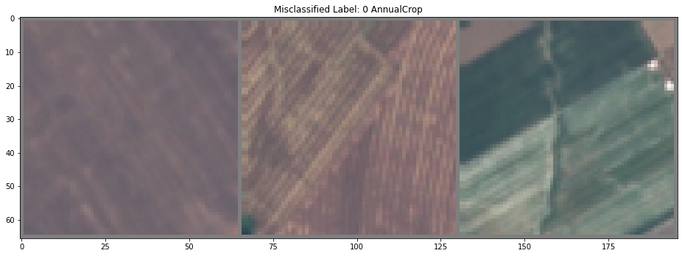
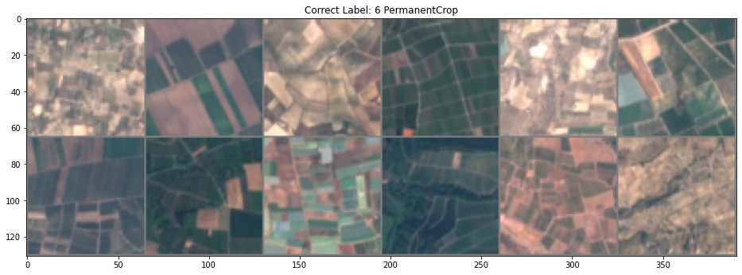
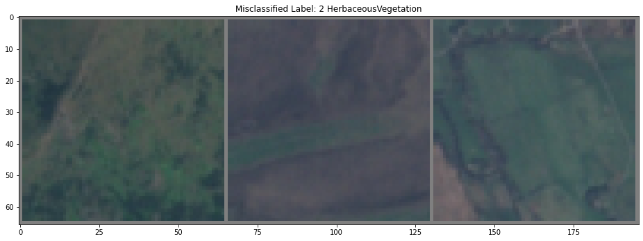
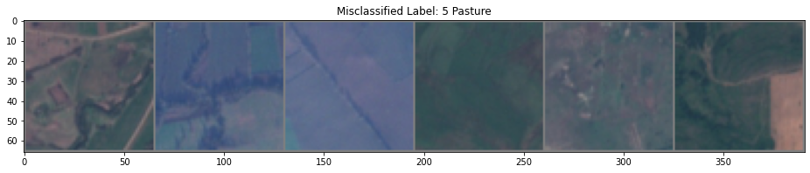
ResNet Models - Version 3
Top misclassified Label: PermanentCrop
Fig: Sample of accurately classified PermanentCrop images
Fig: Samples from misclassified images as PermanentCrop
Notes:
Anjana

Slide 24
Land Use Classification with Transfer Learning - AlexNet
Based on: Pytorch AlexNet model, Weights: AlexNet_Weights.IMAGENET1K_V1
AlexNet - V1
AlexNet - V2
AlexNet - V3
Feature extraction only
Only replace the last classifier to match our num_classes
model.classifier[6] = nn.Linear(4096,num_classes)
Weights in the body of the CNN are frozen
Performed finetuning
A modified classifier layer is added to the body of the CNN
New classifier layer
Three Linear hidden layers with ReLU and Dropout
Softmax output layer
Weights in the body of the CNN are frozen
Performed finetuning
A modified classifier layer is added to the body of the CNN
New classifier layer
Four Linear hidden layers with ReLU and Dropout
Softmax output layer
Weights in the body of the CNN are frozen
Notes:
Anjana

Slide 25
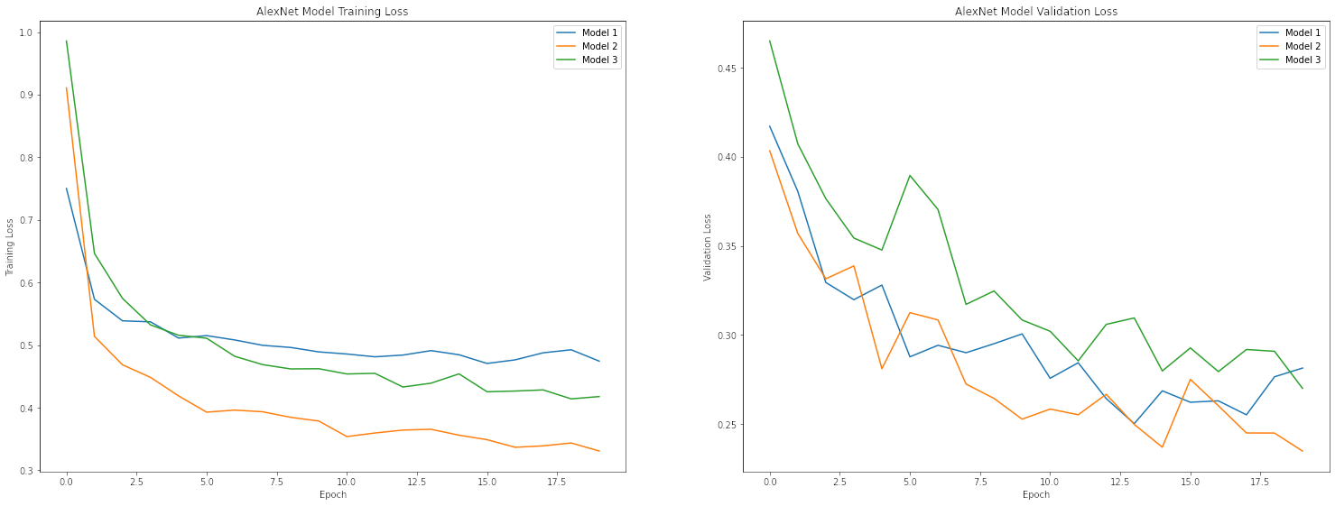
AlexNet Models - Comparison of Training and Validation Loss
Notes:
Anjana

Slide 26
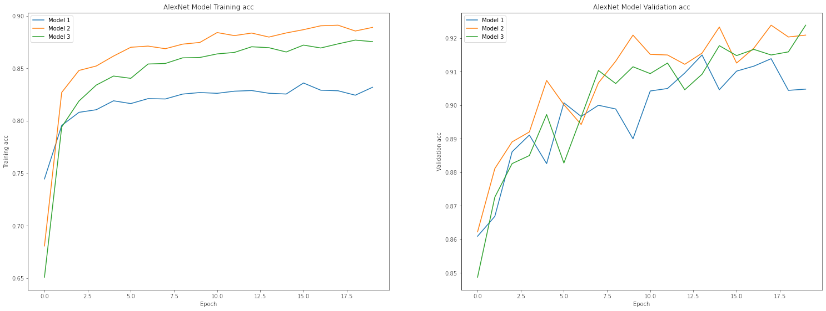
AlexNet Models - Comparison of Training and Validation Accuracy
Notes:
Anjana

Slide 27
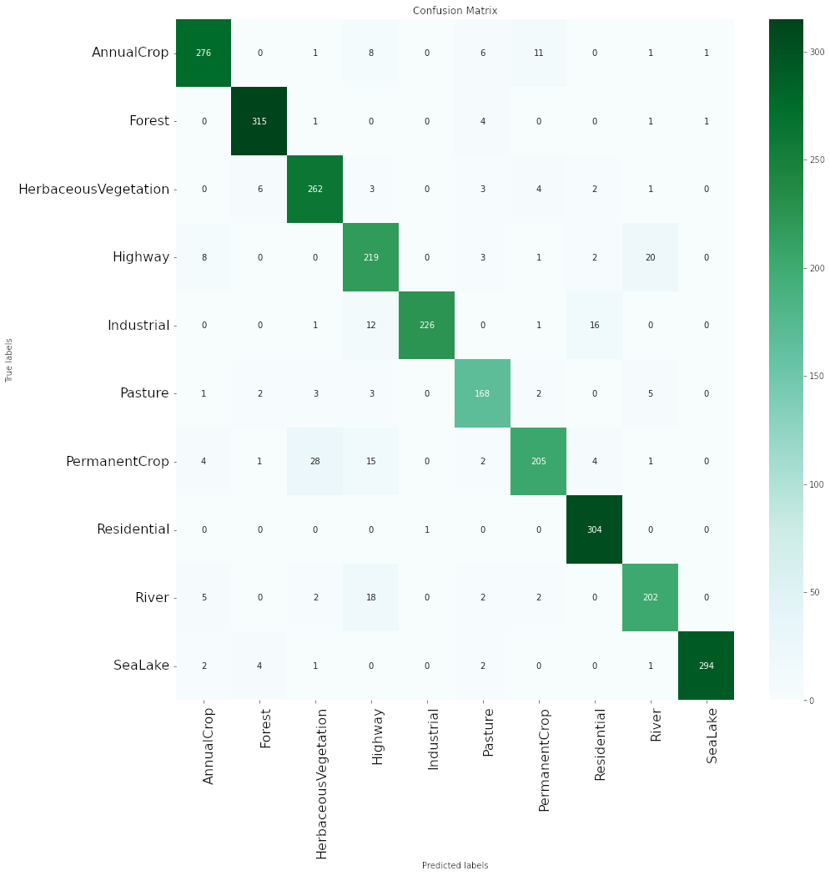
AlexNet Models - Version 2
Fig: Confusion matrix
Maximum confusion is Permanent Crop being classified as Herbaceous Vegetation
Notes:
Anjana

Slide 28
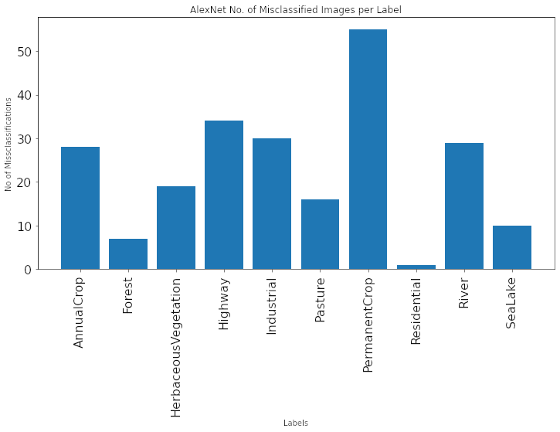
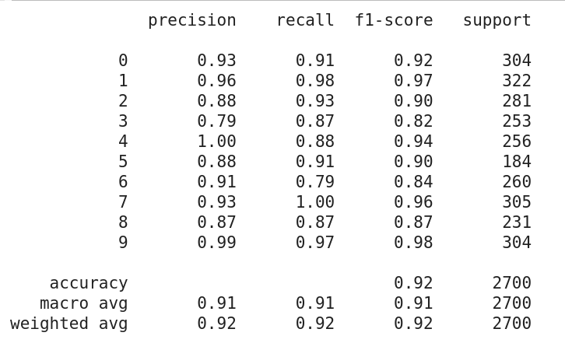
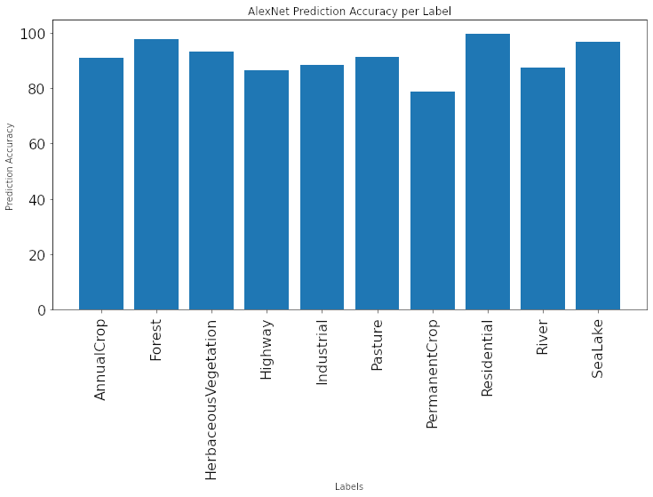
AlexNet Models - Version 2
Total Misclassified Images: 229 / 2700
Fig: No. of Misclassified Images per Label, Prediction Accuracy per Label and Classification Report
Notes:
Anjana

Slide 32
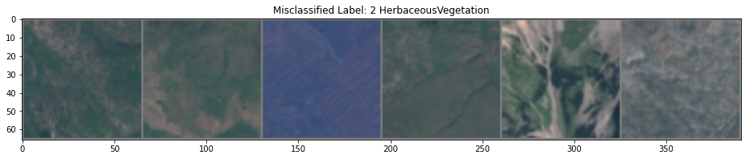
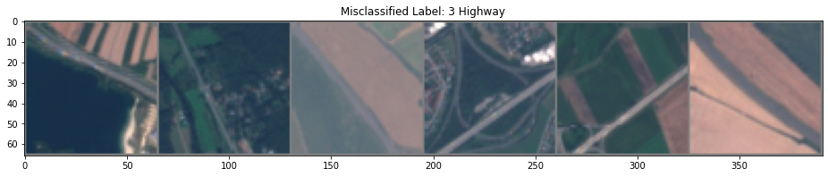
AlexNet Models - Version 2
Top misclassified Label: PermanentCrop
Fig: Sample of accurately classified PermanentCrop images
Fig: Samples from misclassified images as PermanentCrop
Notes:
Anjana

Slide 33
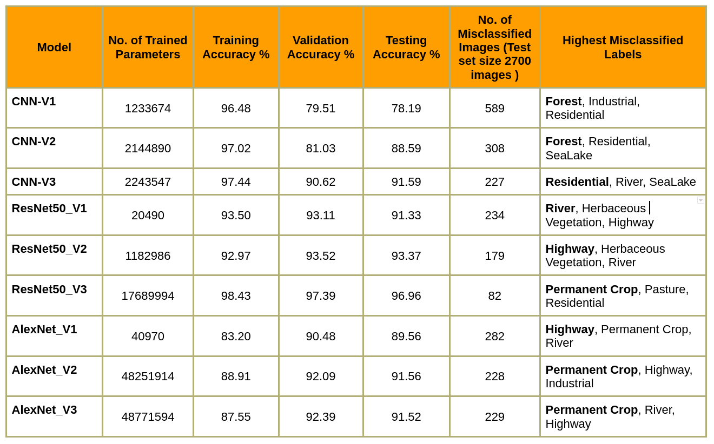
Comparison of Results
Notes:
Sakib

Slide 34
Conclusion
For the EuroSat dataset, best result for land use classification was achieved in the Resnet Ver3:
Finetuend ResNet50 model with ResNet50_Weights.IMAGENET1K_V2 initial weights
The new FC layer we added to the network has:
Two Linear hidden layers with ReLU and Dropout
Softmax output layer
We unfreezed the body of the network (except BatchNorm2d layers) and train the entire network with training data samples obtained from the EuroSat dataset.
Deep learning solutions based on remote sensing data such as satellite imagery is an accurate and efficient method of land use classification.
Notes:
Sakib

Slide 35
Conclusion
At present, land use classification is needed in many of the real world applications related to:
Forests management, agriculture,, coastal and inland and water quality monitoring, land ecosystems monitoring, disaster mapping, and civil security.
Accurate land use classification will immensely assist in:
Efficient monitoring of land use changes
Effective land cover planning and management
We hope that with our study we will be able to make a contribution to the field of LULC.
Notes:
Sakib

Slide 36
Future Work
Further improve deep learning model accuracy by training the models with:
Data from RGB bands + Near-infrared spectral bands (B05-B08A) available in the dataset.
Benchmark our models with other satellite image datasets such as:
Landsat 8 and Landsat 6 datasets
Study/research on object detection and image segmentation techniques
This will be enable us to built comprehensive solution targeted at real time land monitoring and change reporting.
Example:
Monitoring a forest cover in a water catchment area or a large body of water such as a lake and reporting percentage of change on weekly basis.
These information will assist authorities to make informed decisions on water distribution for domestic use and farming for the near future.
Notes:
Sakib

Slide 37
References
[1] S. Basu, S. Ganguly, S. Mukhopadhyay, R. DiBiano, M. Karki, and R. Nemani, “Deepsat: a learning framework for satellite
imagery,” in Proceedings of the 23rd SIGSPATIAL international conference on advances in geographic information systems, 2015,
pp. 1–10.
[2] R. Naushad, T. Kaur, and E. Ghaderpour, “Deep transfer learning for land use and land cover classification: A comparative study,”
Sensors, vol. 21, no. 23, p. 8083, 2021.
[3] P. Kowaleczko et al., “MuS2: A Benchmark for Sentinel-2 Multi-Image Super-Resolution,” arXiv preprint arXiv:2210.02745, 2022.
[4] J. Cornebise, I. Oršolić, and F. Kalaitzis, “Open High-Resolution Satellite Imagery: The WorldStrat Dataset–With Application to
Super-Resolution,” arXiv preprint arXiv:2207.06418, 2022.
[5] P. Helber, B. Bischke, A. Dengel, and D. Borth, “Introducing eurosat: A novel dataset and deep learning benchmark for land use and land cover classification,” in IGARSS 2018-2018 IEEE international geoscience and remote sensing symposium, 2018, pp. 204–207.
[6] P. Helber, B. Bischke, A. Dengel, and D. Borth, “Eurosat: A novel dataset and deep learning benchmark for land use and land cover classification,” IEEE Journal of Selected Topics in Applied Earth Observations and Remote Sensing, vol. 12, no. 7, pp. 2217–2226, 2019.
[7] N. A. Mahmon, N. Ya’acob, and A. L. Yusof, “Differences of image classification techniques for land use and land cover classification,” in 2015 IEEE 11th International Colloquium on Signal Processing & Its Applications (CSPA), 2015, pp. 90–94.
[8] R. Naushad, T. Kaur, and E. Ghaderpour, “Deep transfer learning for land use and land cover classification: A comparative study,” Sensors, vol. 21, no. 23, p. 8083, 2021.

Slide 38
Q and A

Slide 39
Thank you.

Slide 40
Appendix

Slide 41
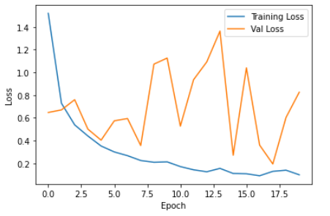
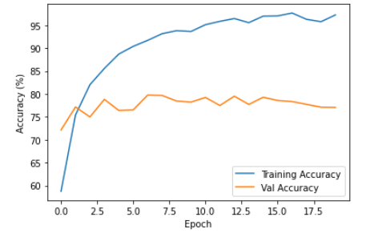
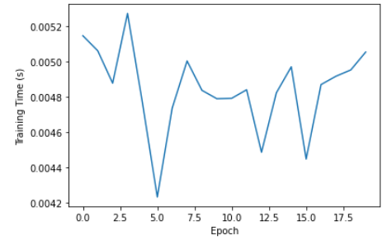
Plotting loss, accuracy, and training time: Model 1

Slide 42
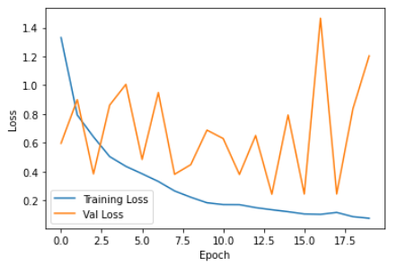
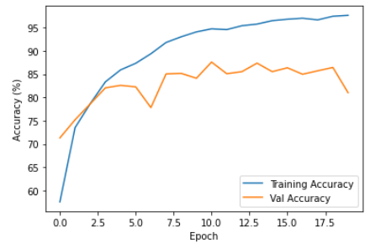
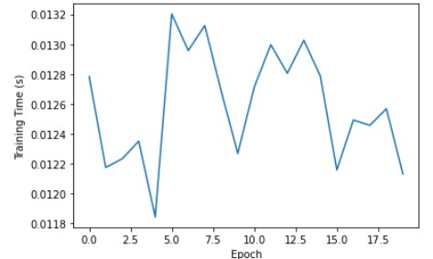
Plotting loss, accuracy, and training time: Model 2

Slide 43
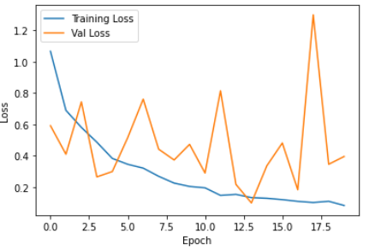
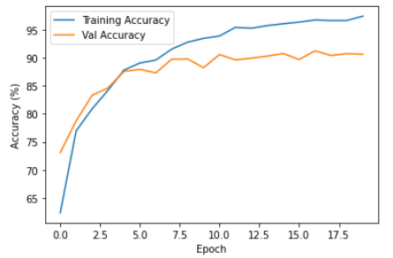
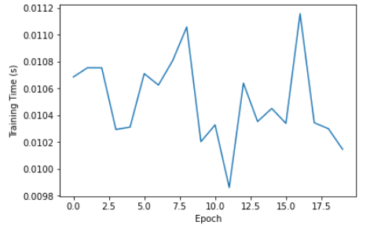
Plotting loss, accuracy, and training time: Model 3

Slide 44
Compare 3 models: Train loss

Slide 45
Compare 3 models: Validation loss

Slide 46
Compare 3 models: Train accuracy and Validation accuracy

Slide 47
Testing/Inferencing
Model | Accuracy
Model 1 | 78.19
Model 2 | 88.59
Model 3 | 91.59

Slide 48
Total number of misclassified images
Model | Total
Model 1 | 1178
Model 2 | 616
Model 3 | 454

Slide 49
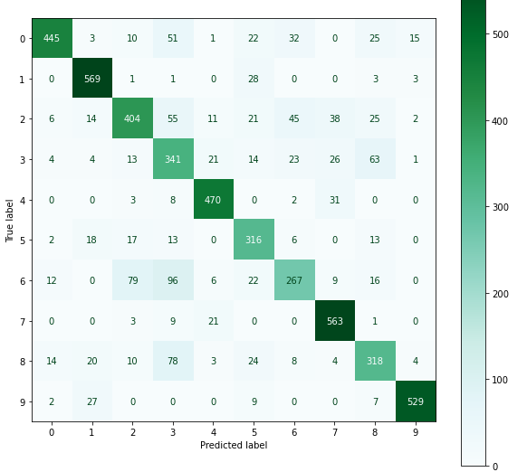
Confusion matrix: Model 1

Slide 50
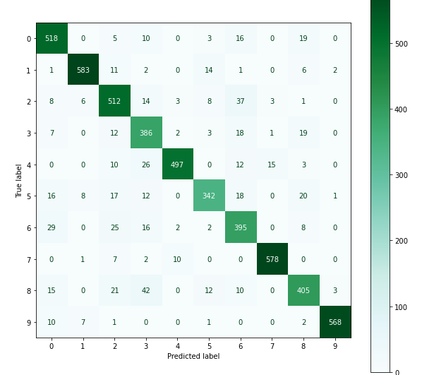
Confusion matrix: Model 2

Slide 51
Confusion matrix: Model 3

Slide 52
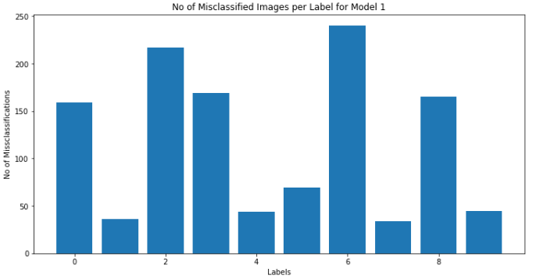
Examine misclassified images: Model 1
Total Misclassified Images: 1178

Slide 53
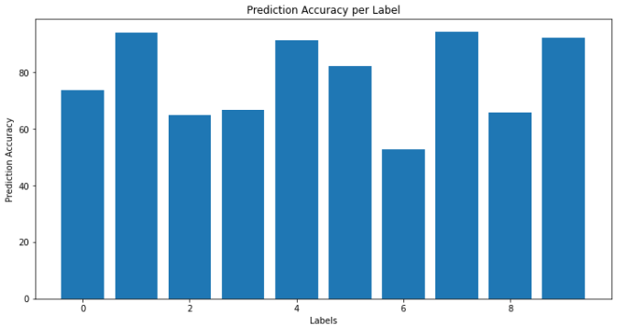
Prediction accuracy per label: Model 1
Low accuracy labels: 2, 3, 6, 8

Slide 54
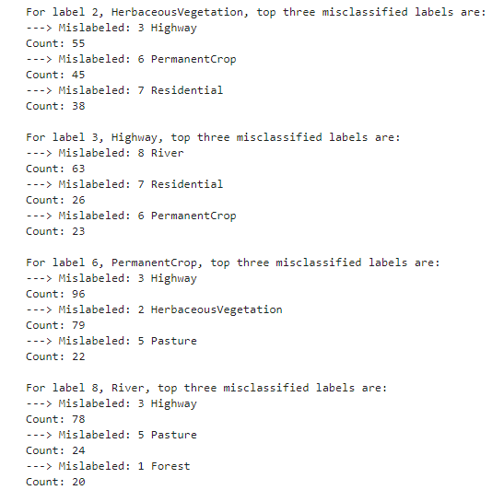
Counting top 3 mislabeled

Slide 55
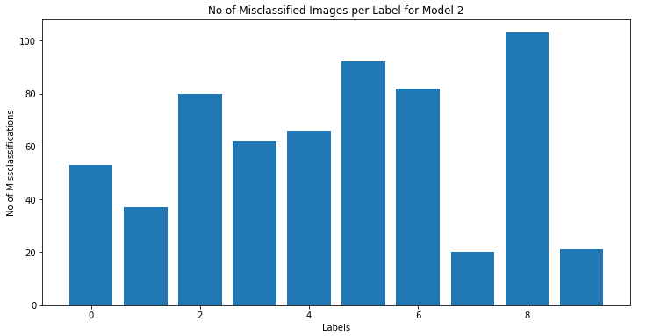
Examine misclassified images: Model 2
Total Misclassified Images: 616

Slide 56
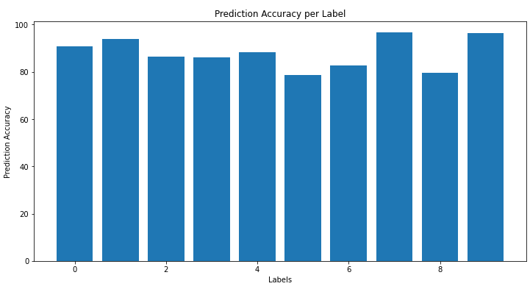
Prediction accuracy per label: Model 2
Low accuracy labels: 5, 6, 8

Slide 57
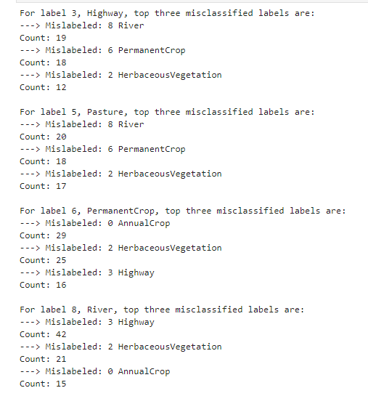
Counting top 3 mislabeled

Slide 58
Examine misclassified images: Model 3
Total Misclassified Images: 454

Slide 59
Prediction accuracy per label: Model 3
Low accuracy labels: 0, 6

Slide 60

Counting top 3 mislabeled

